Slide 1
Darshan University
--Krish Patel

Slide 2
About Darshan University
Darshan University (DU) is a prominent institution offering a broad slate of academic programs and professional courses at the undergraduate, graduate, and postgraduate levels in Engineering & Technology, Science, Management, and Yoga
The University is located in peaceful and sylvan surroundings with a distinctive collegiate structure, about 19 km from Rajkot, Gujarat, India. It was established as an Engineering Institute in 2009 by Shree G. N. Patel Education & Charitable Trust with the objective of imparting quality education and training in various fields of Engineering and Technology.
It has since been transformed into Darshan University through an Act by the Government of Gujarat under the Gujarat State Private Universities (Amendment) Act, 2021 (Act No. 15).

Slide 3
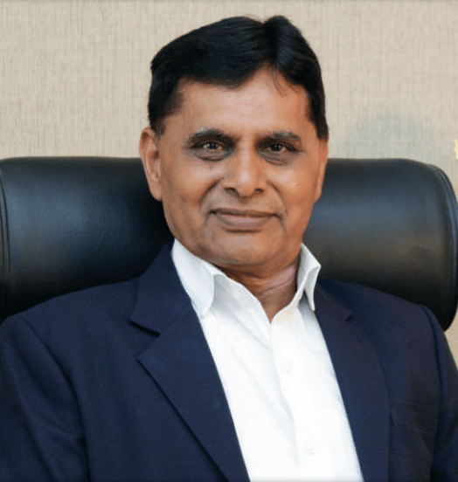

Ramnik G. Dhamsaniya Manish V. Sanghani

Slide 4
Program Offered (About Darshan University and Our Motto)
Admission 2026
Direct Admission for all programs has already started.
Apply Now
For admission regarding query: +91-7096979952 +91-7096979962
Diploma (After 10th)
Computer Engineering
Civil Engineering
Electrical Engineering
Mechanical Engineering

Slide 5
Why Darshan University ?
Academic Staff
Well-Qualified, Experienced, Industry Linked and Dedicated Academic Staff.
Industry Oriented Curriculum
Curriculum includes latest technologies as per industry demands.
Project-based Learning
Extensive student-corporate interaction through internships and projects.
Skill Development Activities
Focus on skill development activities to make students industry-ready.

Slide 6
Scholarships
[1] MYSY (Mukhyamantri Yuva Swalamban Yojana)
Eligibility: Student must have secured 80 or more Percentile in 10th / 12th exam and family income must be less than Rs. 6 lakh/annum.
Amount of Scholarship:
For Degree Engineering: Rs. 50,000/- or 50% of tuition fees whichever is less.
For Diploma Engineering: Rs. 25,000/- or 50% of tuition fees whichever is less.
For B.Com./BBA/BCA/B.Sc.: Up to Rs. 10,000/- or 50% of tuition fees whichever is less.
[2] Scholarships for SC/ST Students
Eligibility: Student must belong to SC or ST category and family income must be less than Rs. 2,50,000/annum.
Amount of Scholarship: Approximately 100% of tuition fees as per Government norms.

Slide 7
Placement of Last 3 years

Slide 8
Course
# | Course Name | Type | Credits | Contact Hours per Week
 |  |  |  | Theory | Tutorial | Practical
1 | Office Automation Tools * | BS | 3 | 2 | 0 | 2
2 | Life Management & Human Values * | HS | 2 | 2 | 0 | 0
3 | Operating System | PC | 4 | 3 | 0 | 2
4 | PHP and WordPress | PC | 4 | 3 | 0 | 2
5 | Python Programming | PC | 4 | 3 | 0 | 2
6 | Open Elective - I | OE - I | 3 | 3 | 0 | 0

Slide 9
Thankk Youu
----Presented by The Krish Patel

